Slide 1
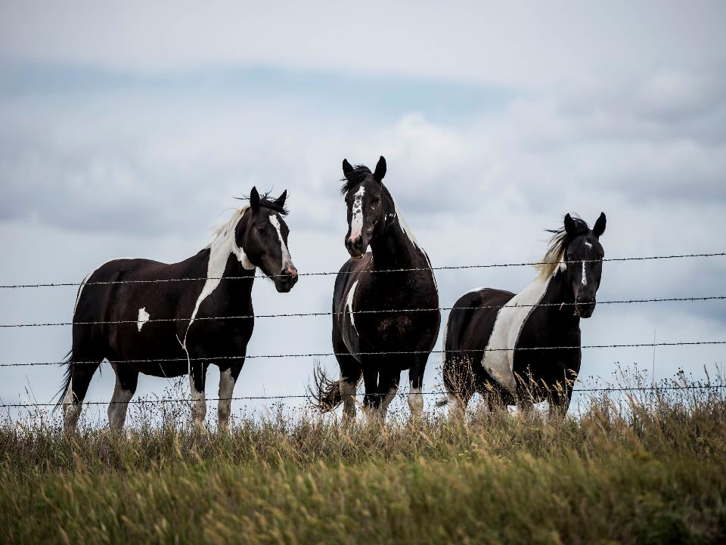
Managing horse pasture
DALE STRICKLER

Slide 2
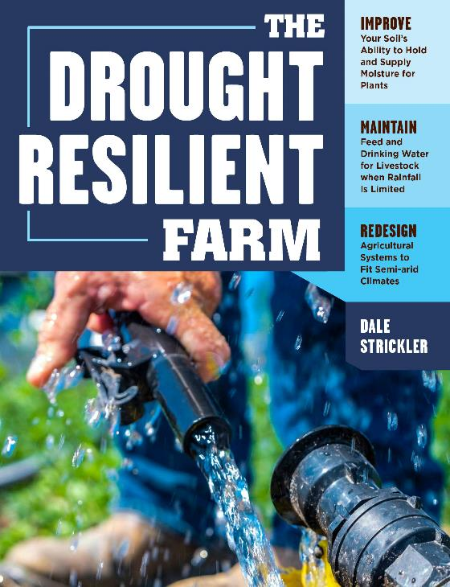
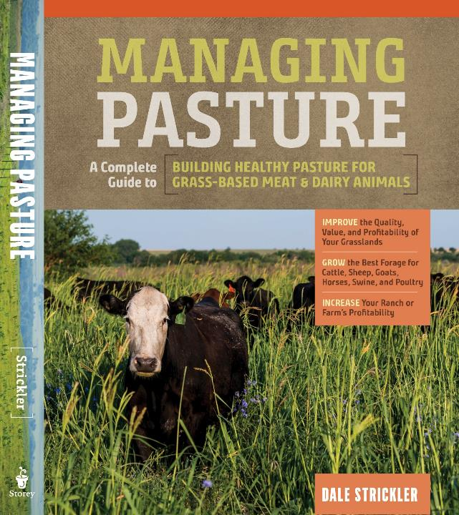
I wrote 2 books!
Available in bookstore or email me for your copy (dalestrickler613@gmail.com)

Slide 3
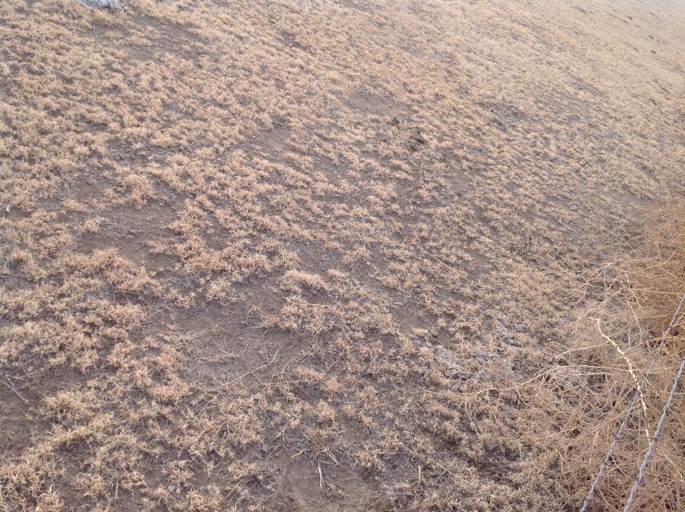
#1 RULE:
NEVER OVERGRAZE!

Slide 4
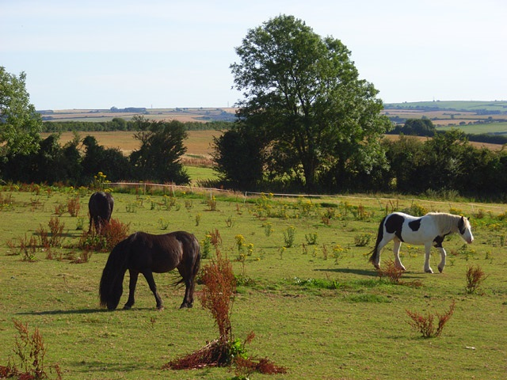
Most common problem with horse pastures
Too many horses for too few acres!
Notes:
Overgrazed Pasture - is a major cause of soil degradation.

Slide 5
% nongrowing roots
% leaf removal RhG SB KB
-------------------------------------------------------------------
10 0 0 0
20 0 0 0
30 0 0 0
40 0 0 0
50 2 13 38
60 50 36 54
70 78 76 77
80 100 81 91
90 100 100 100
RhG=rhodesgrass, SB=smooth bromegrass, KB =Kentucky bluegrass

Slide 6
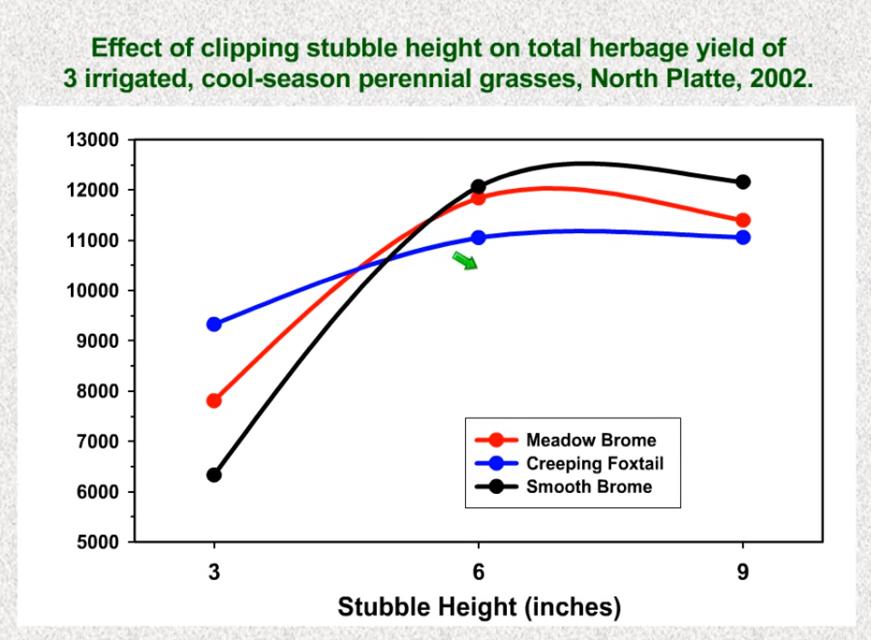

Slide 7
More residual left at end of grazing period means:
higher quality forage eaten by animal (get to select out best plant parts)
higher yield at next grazing period
higher litter amount on soil (cooler soil in summer, warmer in late fall)
higher soil biological activity in soil
higher soil organic matter, better carbon sequestration
lower runoff, better water infiltration
deeper root development
less soil erosion

Slide 8
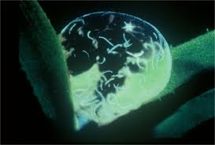
Parasites in a dew drop

Slide 9
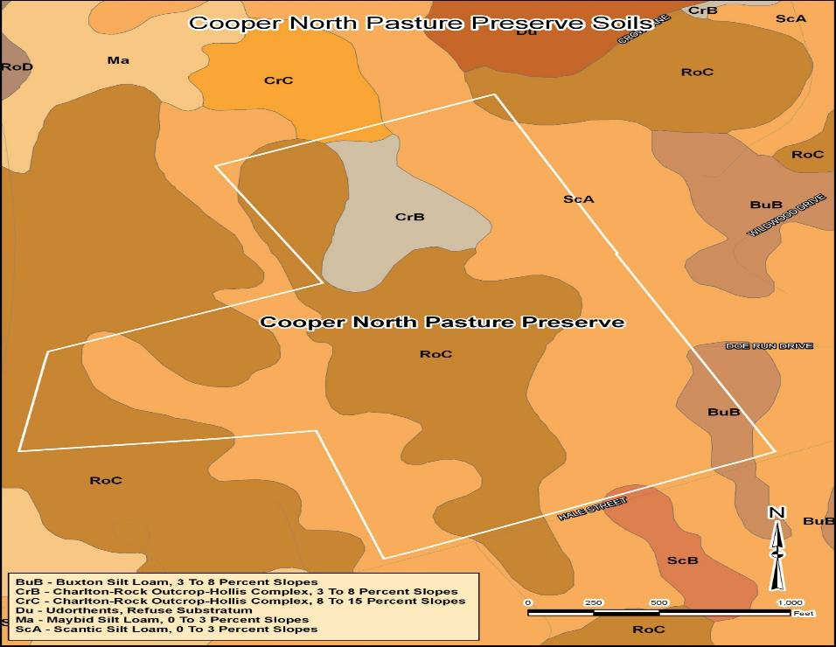
Developing a stocking rate that works in good times or bad
Enlist the help of NRCS; they can predict what grass production will occur in a favorable, average or drought year using soil types and range condition

Slide 10
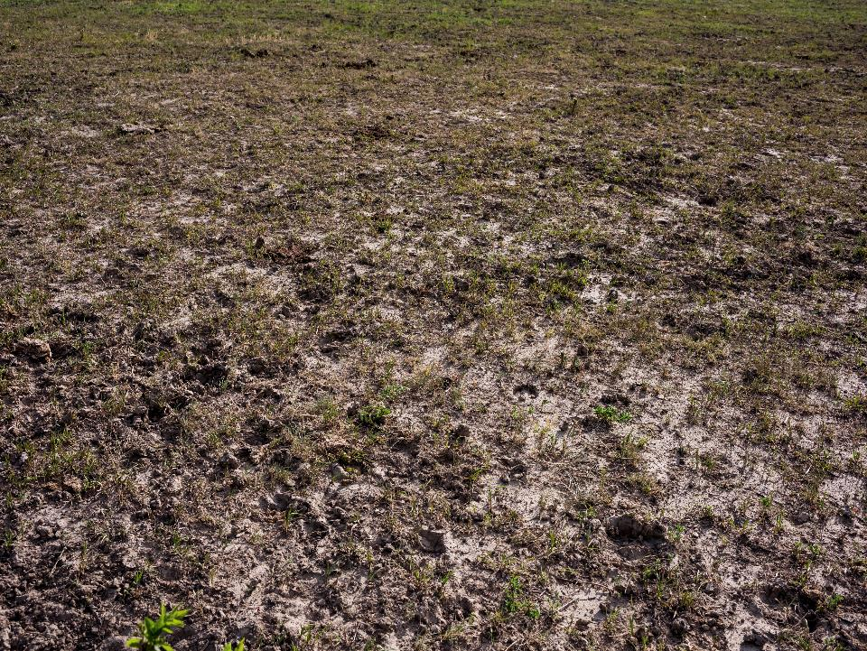
How to avoid overgrazing when you have more animals than grass?
Reduce animal demand (reduce amount of pasture eaten per animal, or reduce animal numbers)
Or….
Increase the productivity of the pasture

Slide 12
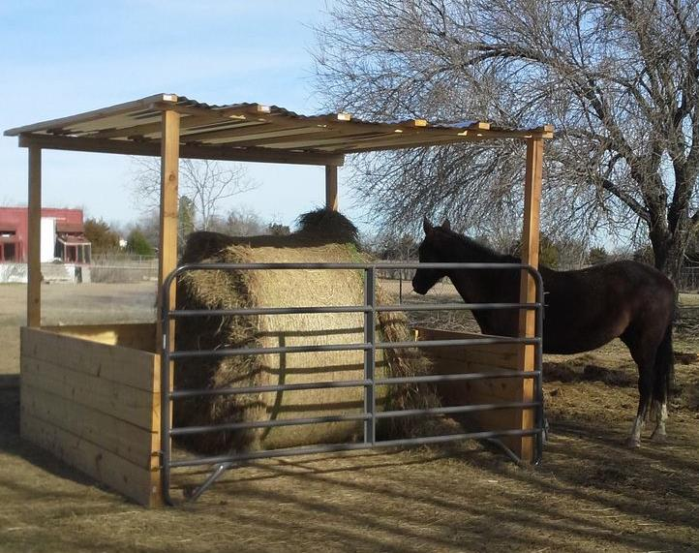

Slide 13
Time limit grazing
Batt-Latch Gate Release Timer
Notes:
The Batt-Latch is an automatic gate opener, supplied with a self-closing gate spring. The system makes it possible to have the self-closing gate spring open automatically at pre-programmed times.

Slide 14
Time limit grazing

Slide 15
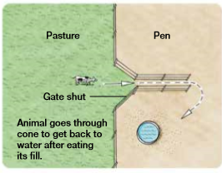

Slide 16
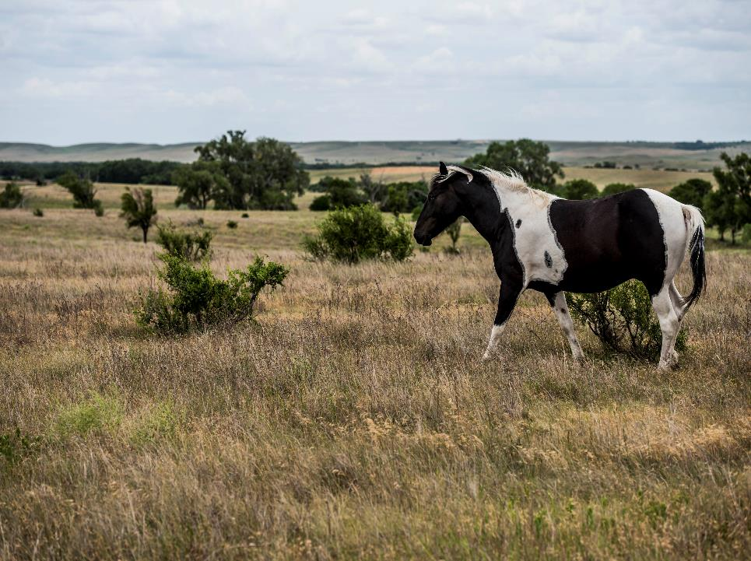
What makes pasture grow?

Slide 17
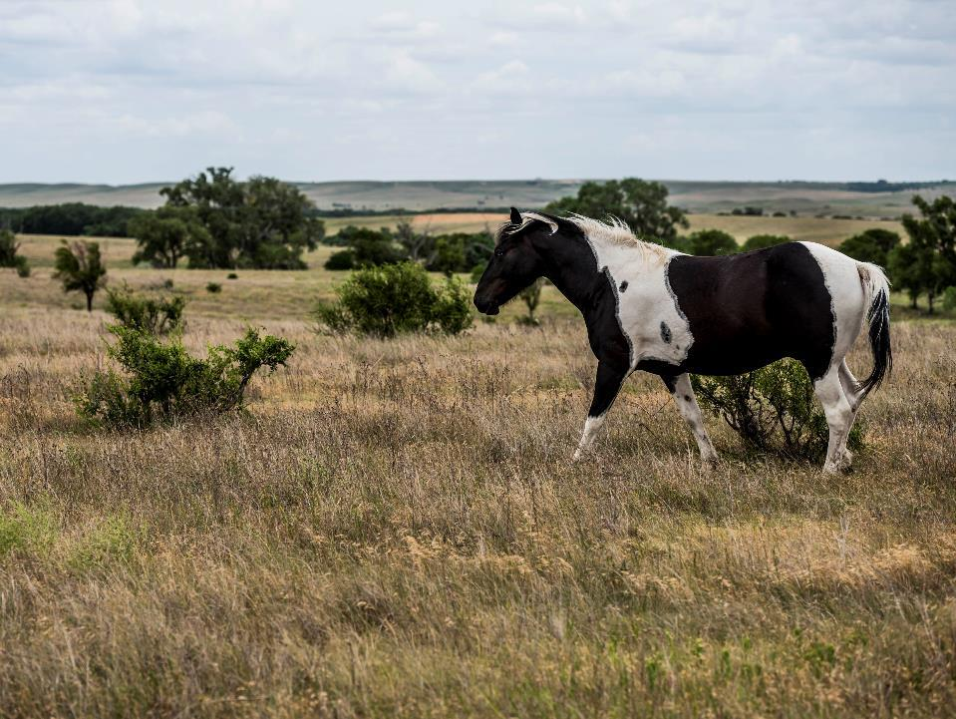
Pasture growth factors
Sunlight
Water
CO2
O2
Optimum temperatures
Mineral nutrients

Slide 18
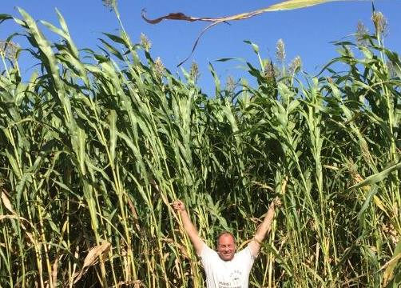
Making your pasture more productive-
Improve capture and conversion of sunlight
Minimize water deficit periods
Add organic materials
Add mineral nutrients
Reduce compaction
Improve grazing distribution

Slide 19
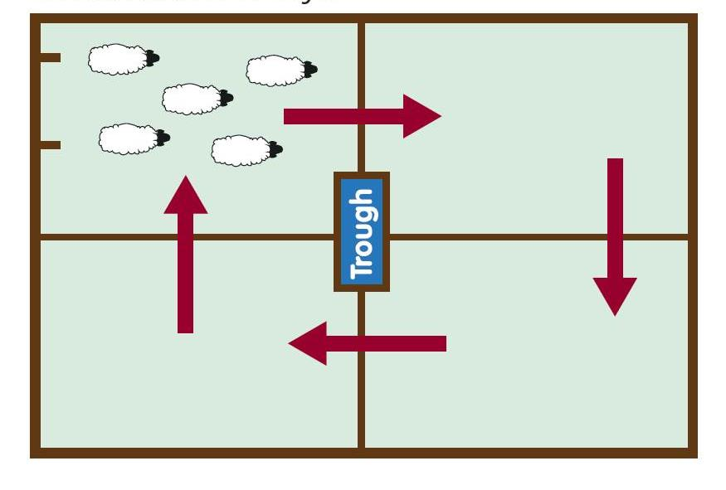
Notes:
Rotational Grazing

Slide 20
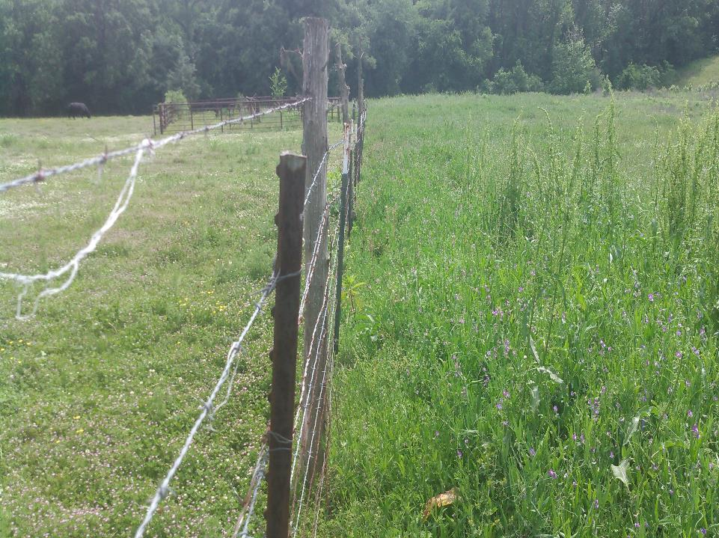

Slide 21
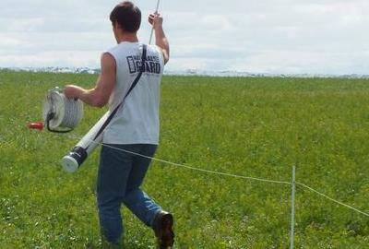
Notes:
Electric Fence

Slide 22
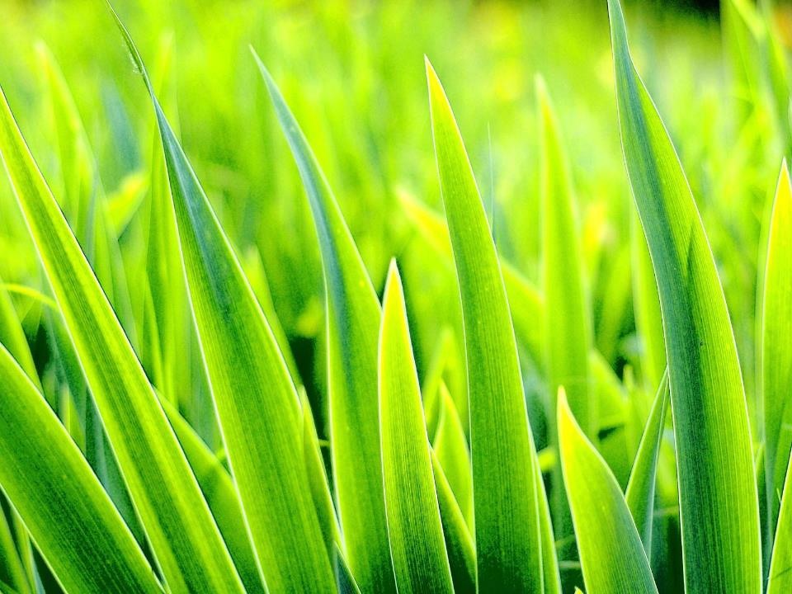
The grass lifecycle
Vegetative
Reproductive
Dormant

Slide 23
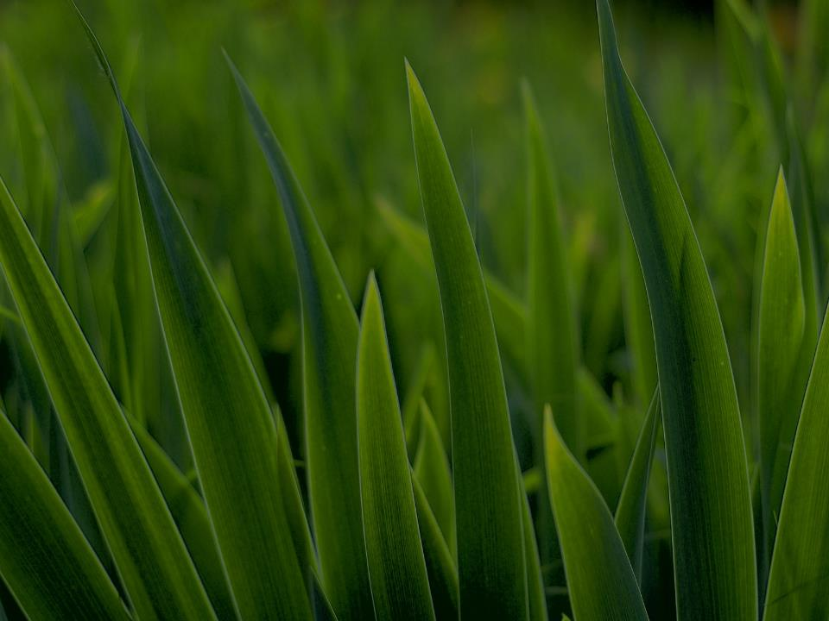
Vegetative
Highest forage quality
Good tolerance to defoliation, as long as sufficient leaf area remains to maintain photosynthesis; growing points are low

Slide 24
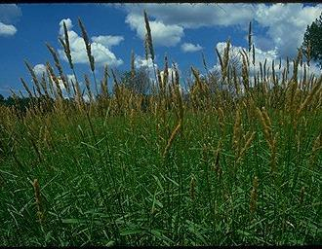
Reproductive
Forage quality drops rapidly
Growing points become elevated, and new leaf production stops, so tolerance to defoliation becomes poor

Slide 25
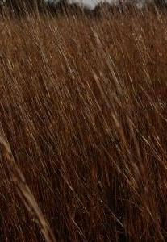
Dormant
Non-growing period, all carbohydrates and non-structural protein is moved underground
Quality is poor, but…….
Very tolerant to defoliation !

Slide 27
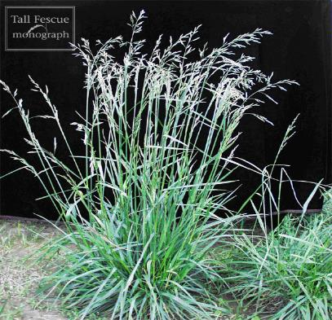
Know your pasture type
Cool-season (fescue, bromegrass)
Warm-season (Native)

Slide 28
Effect of clipping weekly at 1 inch height on wheatgrass (coolseason)
Period clipped Survival
………………………………………………………
Apr 15-May 7 (vegetative) 100%
May 1-May 22 (early repro) 25%
May 15-June 7 (mid repro) 50%
June 1-June 22 (late repro) 55%
Every 2 weeks,
Sept 15-Nov 1 (fall vegetative) 100%
(When would you choose to graze this grass?)

Slide 29
Mowing date on carbohydrate reserves of big bluestem (WS)
Mowing date % carbohydrate in roots
--------------------------------------------------------
Unmowed 7
June 1 8.25
July 1 8.5
Aug 1 6.7
Sept 1 4.4

Slide 30
Timing of clipping on root growth
Species Date Days w/o
clipped root growth
Orchard grass (CS) Apr 28 0
May 20 18
July 7 7
Bermuda grass(WS) May 20 9
June 21 6
Sept 28 16

Slide 31
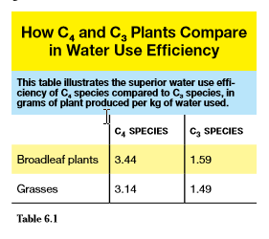

Slide 32
Fescue in bermudagrass- Apr 9

Slide 33
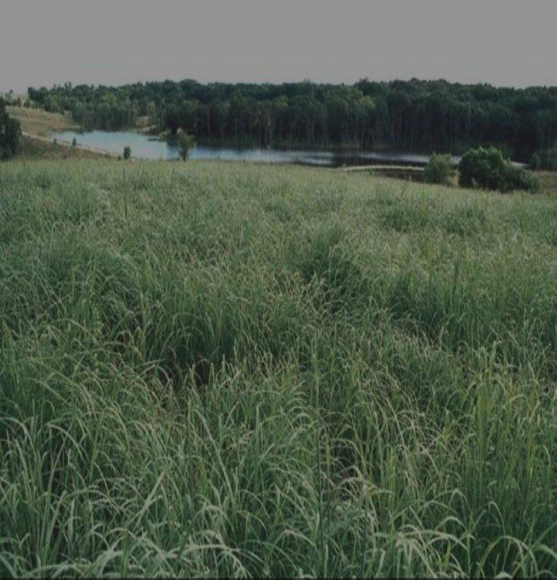
C3 plants (cool-season)
C4 (warm-season)
Less water efficient
Less nitrogen efficient
More cold tolerant
Better forage quality
Grow in spring and fall
More water efficient
More nitrogen efficient
More heat tolerant
Poorer forage quality
Grow in summer

Slide 34
Cool-season vs warm-season grasses
Cool-season
Warm-season
Fescues
Bromes
Orchardgrass
Reed canarygrass
Wheat
Rye
Matua
Bluegrass
Wheatgrass
Bermudagrass
Bahia
Switchgrass
Buffalograss
Eastern gamagrass
Gramas
Indiangrass
Bluestems
Crabgrass
Corn
Sorghum

Slide 35
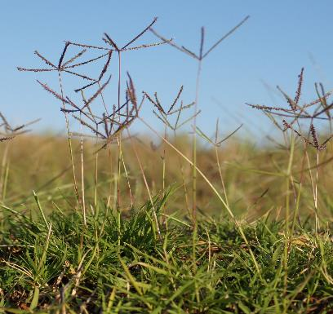
Seasonal suitability grazing
Graze cool-season grasses in spring and fall
Graze warm-season grasses in summer

Slide 36
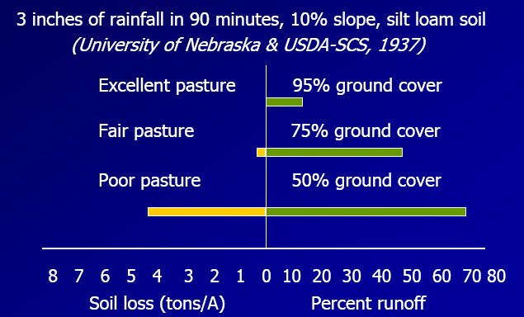
Infiltration

Slide 37
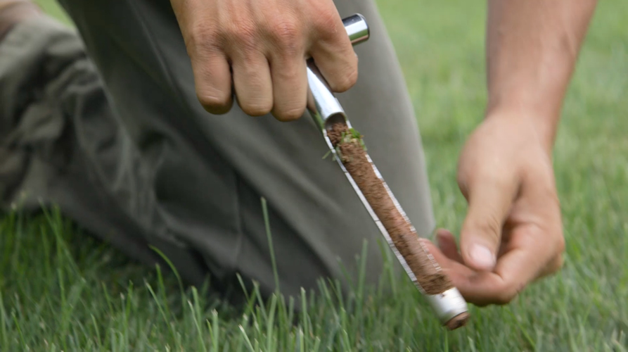
Soil Sampling

Slide 38
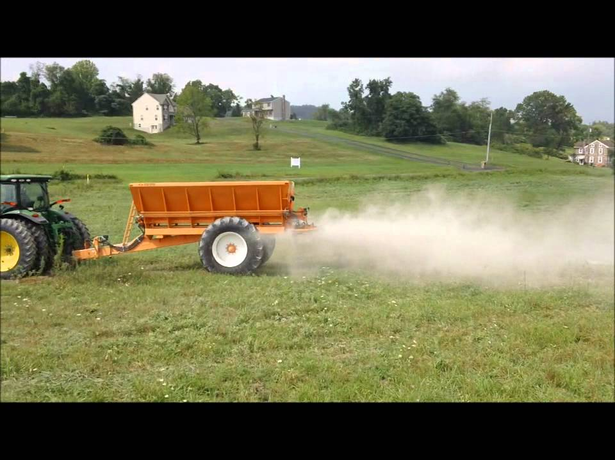

Slide 39
Cool-season grasses NEED additional N to perform L to R: 0, 100, 200, 300 lb N/acre

Slide 40
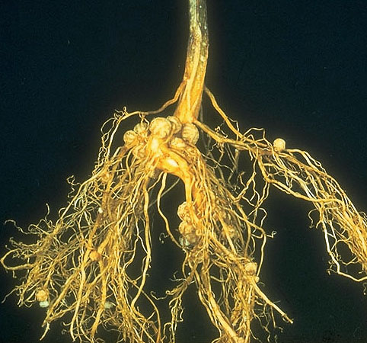

Slide 41
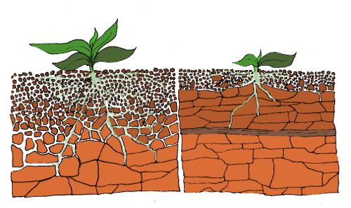

Slide 42
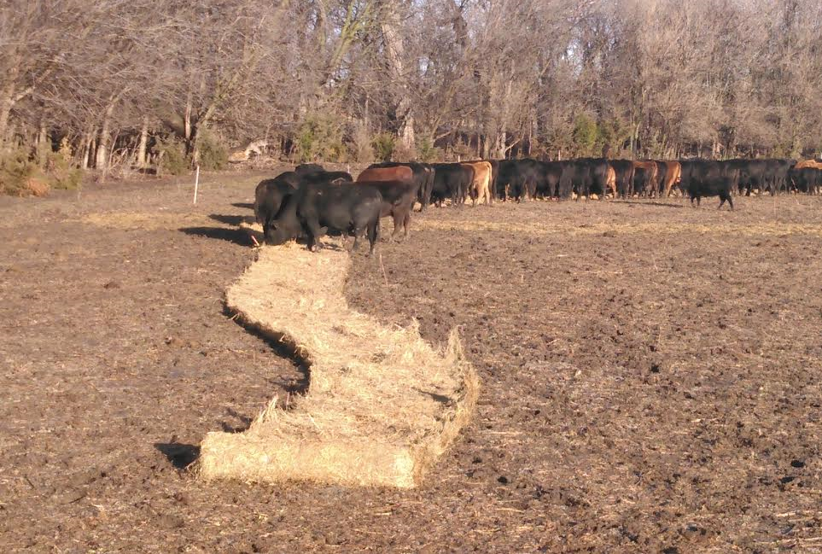
Un-rolling hay bales when feeding allows the feeding location to change.
Notes:
Un-rolling a bale of hay allows the feeding location to change daily. Livestock can spread out along the unrolled hay with less competition and jostling. There is ‘waste’ but that ‘waste’ is covering and adding seed to the soil, feeding the earthworms and soil microbes, and helping to prevent soil erosion. In the summer, some of this ‘hay mat’ will remain serving to reduce water evaporation and keep the soil cool.

Slide 43
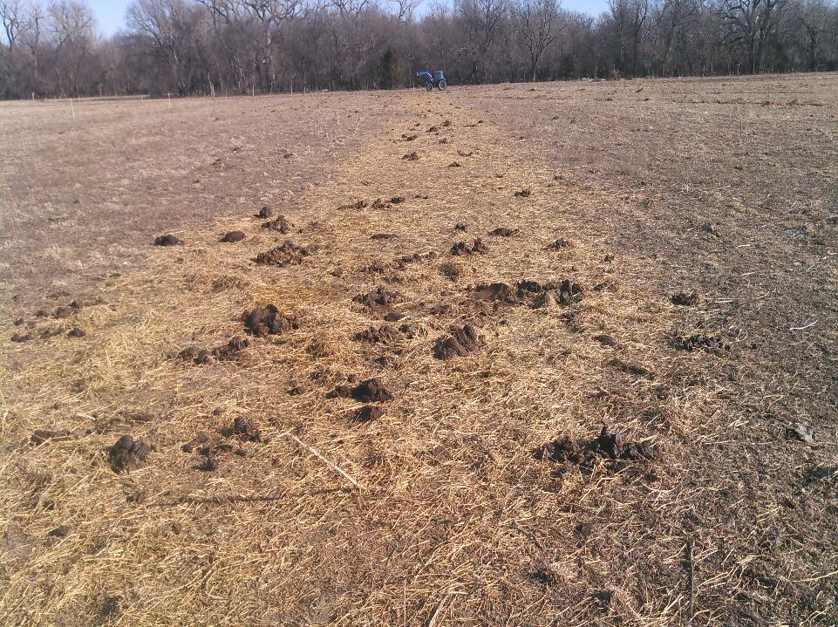
Residue remaining from the unrolled hay bale
Notes:
Residue remaining after the hay is eaten - As livestock consume the hay, most of the phosphorus and potassium pass through the animal in manure and urine and become recycled in the soil. Nutrients in wasted, uneaten hay also become recycled over time.

Slide 44
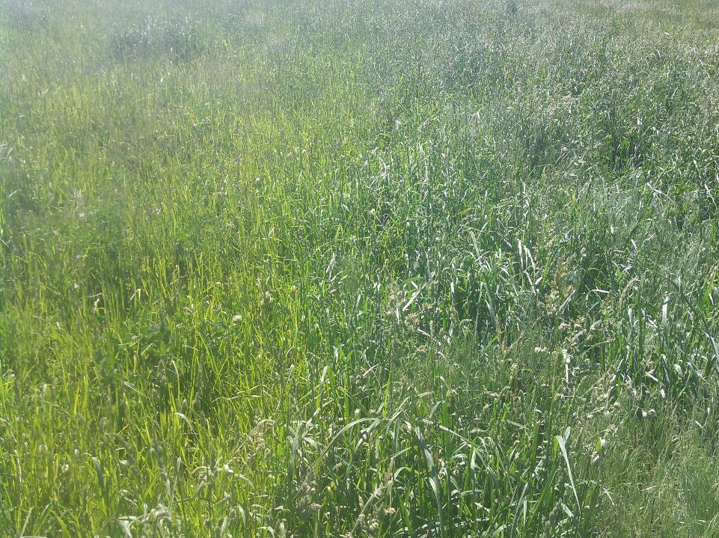
Where the hay bales was unrolled
Notes:
The darker green section is where the round bale was rolled out.

Slide 45
Benefits of bale grazing with purchased hay
Import of nutrients (a ton of grass hay contains about 40 lb Nitrogen, 12 lb phosphate, 6 lb sulfur, 60 lb potash)
Import of organic matter (reduces compaction, feeds soil organisms,
Import of soil armor

Slide 46
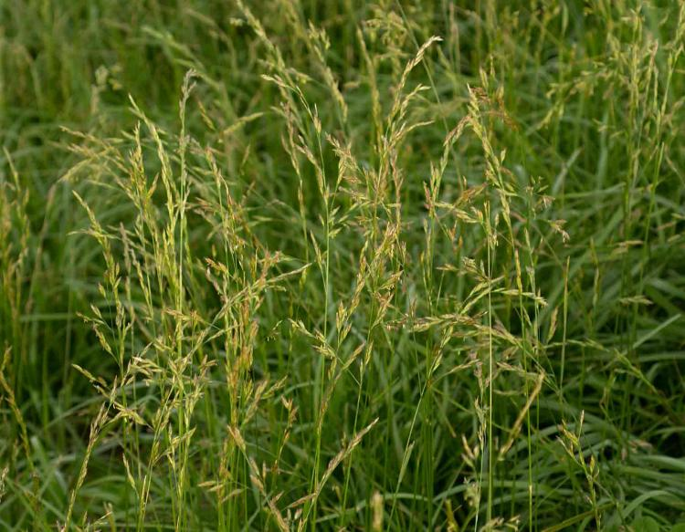
Fescue-the best of grasses, the worst of grasses

Slide 47
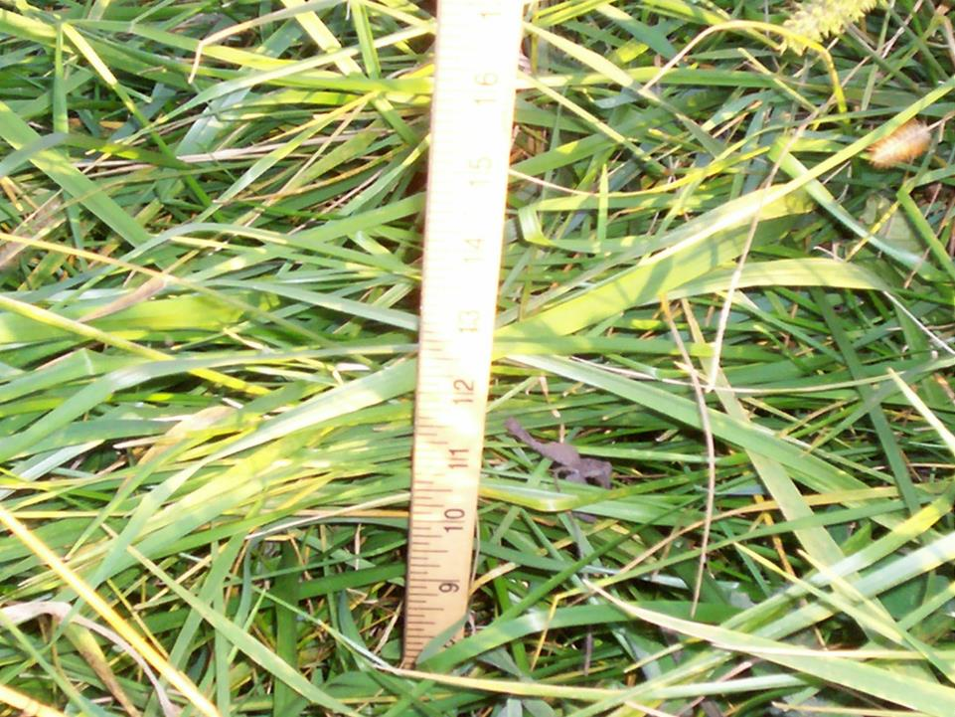

Slide 48
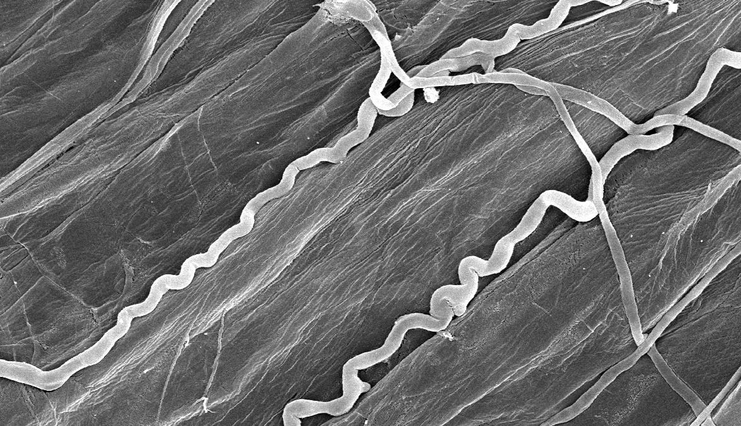
Tall Fescue:
Endophyte infected K31
the endophye and its toxins
© Nick Hill
Notes:
48

Slide 49
Tall Fescue:
steer gains on three types
1999 2000
------- lb/d -------
Toxic endopyte 0.73 0.50
Endophyte-free 1.26 1.56
Novel endophyte 1.30 1.54
Notes:
49

Slide 50
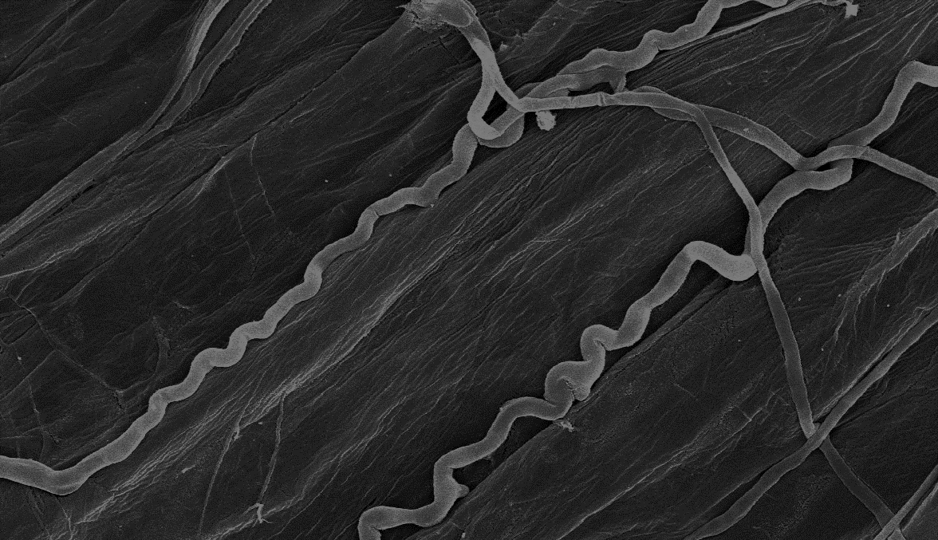
Dealing with fescue endophyte
Kill grass stand and replace
Dilute
Neutralize
Endophyte fungus is only carried by seed, it does not spread from plant to plant
Endophyte only lives about a year in the seed; any seed emerging after two years should be endophyte free

Slide 51
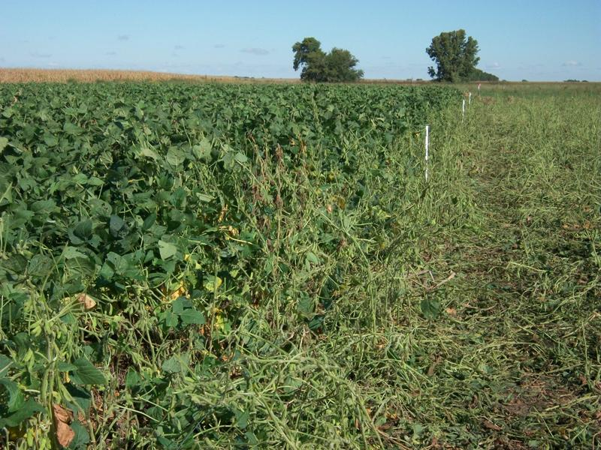
Steps to killing and replacing endophyte infected fescue
1. Prevent seed production
2. Apply glyphosate in November ?(Or can you do it without herbicide?)
3. Plant smother crops of aggressive annuals (for pasture or grain)
4. Keep killing seedlings for at least a year (glyphosate or clethodim or tillage)
5. Replant with better forages

Slide 52
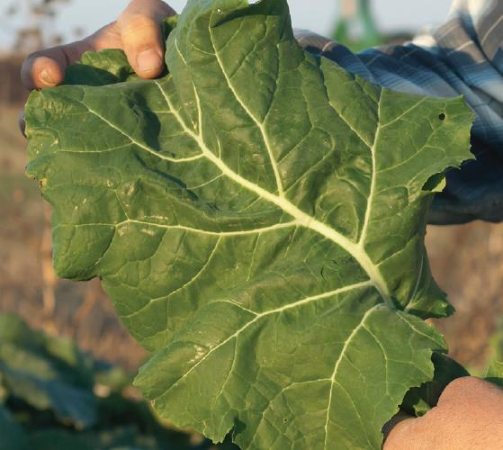
Impact forage collards
Notes:
Forage collard. Great grazing value, very tolerant of both heat and cold, waxy coating keeps it s quality into winter better but makes it harder to kill with herbicide

Slide 53
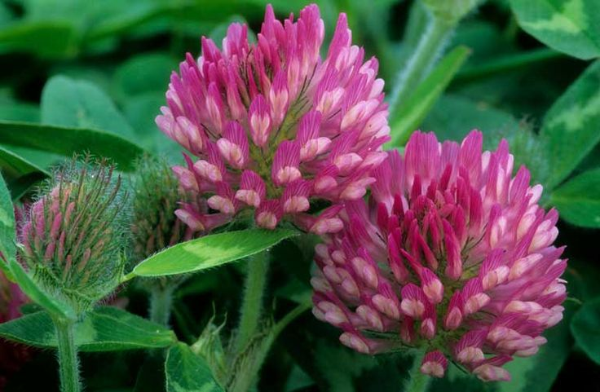
Dilute
Interseed with other forages (fixing mix)
Feed hay or grain (not infected fescue hay)

Slide 54
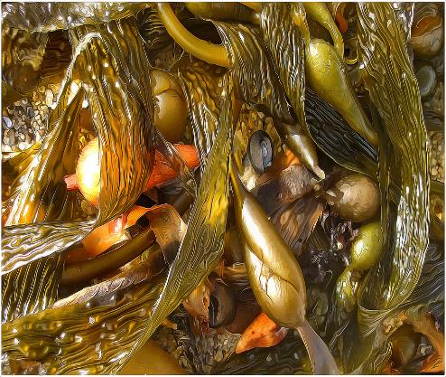
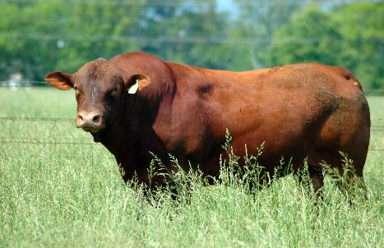
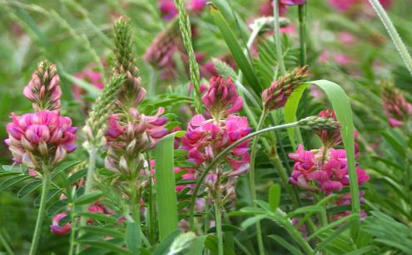
Neutralize
Tannins
Saponins
Animal genetics
Kelp, kelp extract (Tasco),
pepper extract, cinnamon

Slide 55
The fescue fixing mix
5 lb red clover
1 lb ladino clover
2 lb chicory
1 lb plantain
3 lb annual lespedeza
3 lb crabgrass or teff

Slide 56
5 pounds red clover

Slide 57
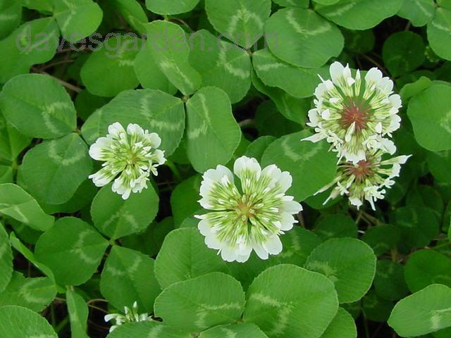
1 pound white clover

Slide 58
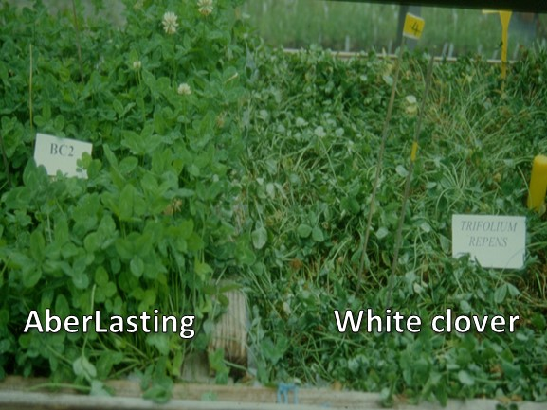
Notes:
AberLasting Clover is a long-lived hybrid perennial that was developed by crossing Caucasian clover with White clover, making it very persistent and drought tolerant. It is nitrogen fixing, fast growing, high in protein and highly digestible. With stolons above ground and rhizomes below, making a faster recovery from heavy grazing.

Slide 59
2 pounds Chicory
Notes:
In addition to its high nutritional value, forage chicory is very drought tolerant thanks to a deep taproot. It grows well in a wide variety of soils and produces both spring and summer forage. Because of this, forage chicory is especially useful to mix in with cool-season grasses and helps supplement the summer down-time of a cool-season pasture.

Slide 60
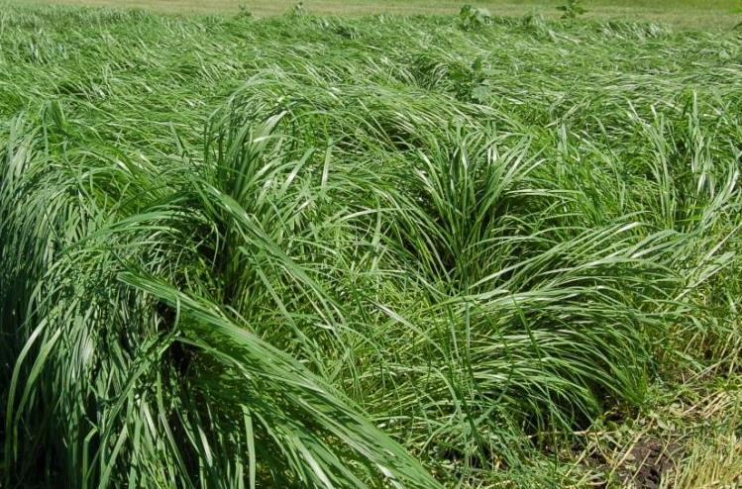
1-5 pound teff or crabgrass
Notes:
Teff is considered a premium hay for a wide range of livestock including dairy, beef, sheep and horses. The “soft forage” is very palatable and readily consumed as dry hay, silage or pasture by livestock.

Slide 61
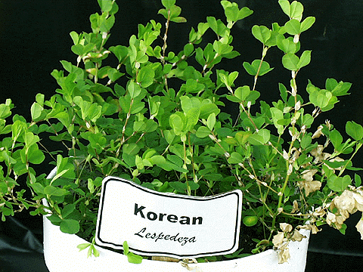
1-5 pounds Korean lespedeza

Slide 62
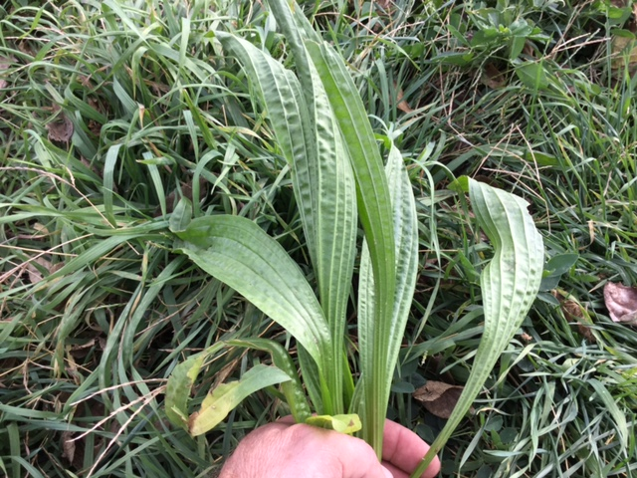
One pound of plantain(no more!)
Notes:
Plantain is a mineral rich perennial grazing herb that is high in protein, up to 23%. It is fast establishing and will be productive and persistent over a wide range of soils and climatic conditions because it has both a tap and fibrous root system. It adapts well to drier regions, less fertile soils, low pH, and heavy clay soils. It responds well to fertilizer, especially nitrogen. Digestibility, (80%), and energy levels, (12MJME), are high with lamb weight gains of 0.55 pounds. Plantain fits very well into grazing mixes and has excellent regrowth as well as very high digestibility.

Slide 63
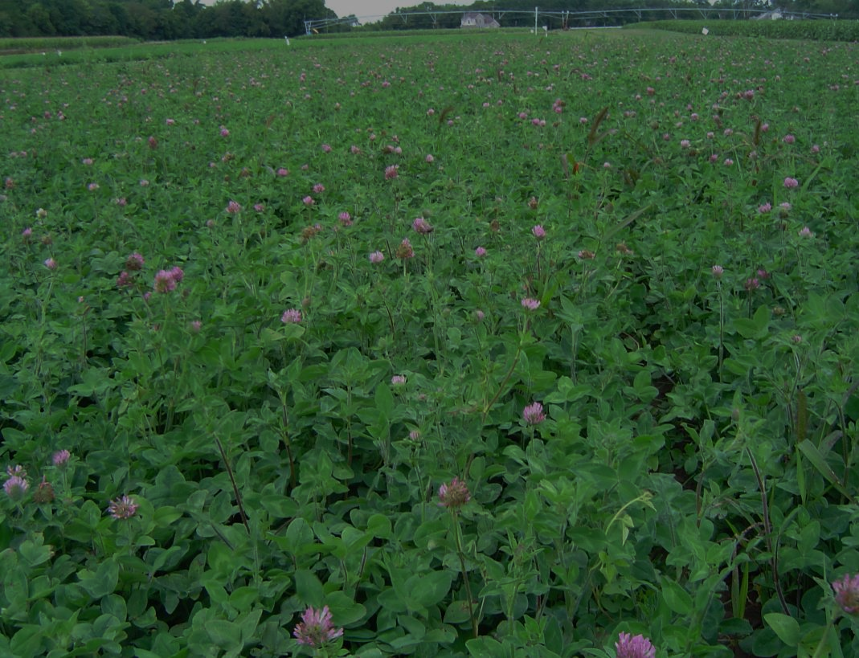
Getting clovers, alfalfa, and forbs established in brome and fescue
Manage pH in soil surface
Manage grazing
Manage crickets and grasshoppers
Inoculate with mycorrhizal fungi
Other microbes?

Slide 64
Sorghums (including Johnsongrass)

Slide 65
Ryegrass

Slide 66
Timothy

Slide 67
Switchgrass

Slide 68
Alsike clover

Slide 69
Hairy vetch

Slide 70
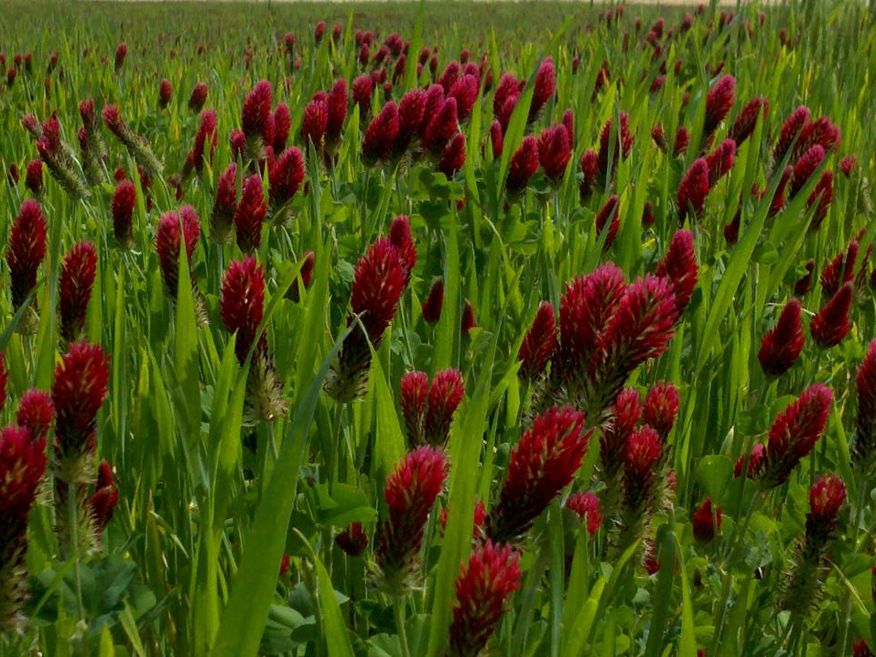
Crimson clover

Slide 71
Other poisonous plants that may occur in pastures
Stone fruits (cherry)
Black locust and honey locust
Black walnut, oaks, elderberry, and maples
Cocklebur
Nightshades (including tomatoes, peppers, etc)
Hemlocks, dogbane, jimsonweed, bindweed
Queen Annes lace,

Slide 72
Slaframine toxicity
s

Slide 73
What to plant for horse pasture
Ideal horse pasture species would be tolerant of close grazing, need no special management, be productive over a long season, and require no fertilizer
It does not exist!
Diversity is key, combine species of different strengths
Some species work better than others

Slide 74
Friendly endophyte tall fescue
Max Q
Baroptima E34+
Texoma
Estancia

Slide 75
Kentucky bluegrass
Not very productive
Very tolerant of close grazing
Only produces in spring in fall

Slide 76
Orchardgrass
Cool-season grass, but grows more than most cool-season grasses in summer
Bunchgrass, does not form a good sod
Not tolerant of close grazing
Mixes well with legumes
Plants thin out over time unless reseeding is allowed

Slide 77
Smooth bromegrass
Very palatable
Not tolerant of close grazing
Forms a sod
Produces mainly in spring

Slide 79
Native tallgrass prairie (warm-season)
Consists of big bluestem, Indiangrass, little bluestem, switchgrass, and sideoats grama, plus a host of minor grasses and wildlfowers
Not tolerant of close grazing
Most productive May through July

Slide 80
Eastern gamagrass

Slide 81
Bermudagrass

Slide 82
Thank you for coming!

